Slide 1
Online Learning for SasView
Michael Oakley
michael.oakley@stfc.ac.uk

Slide 2

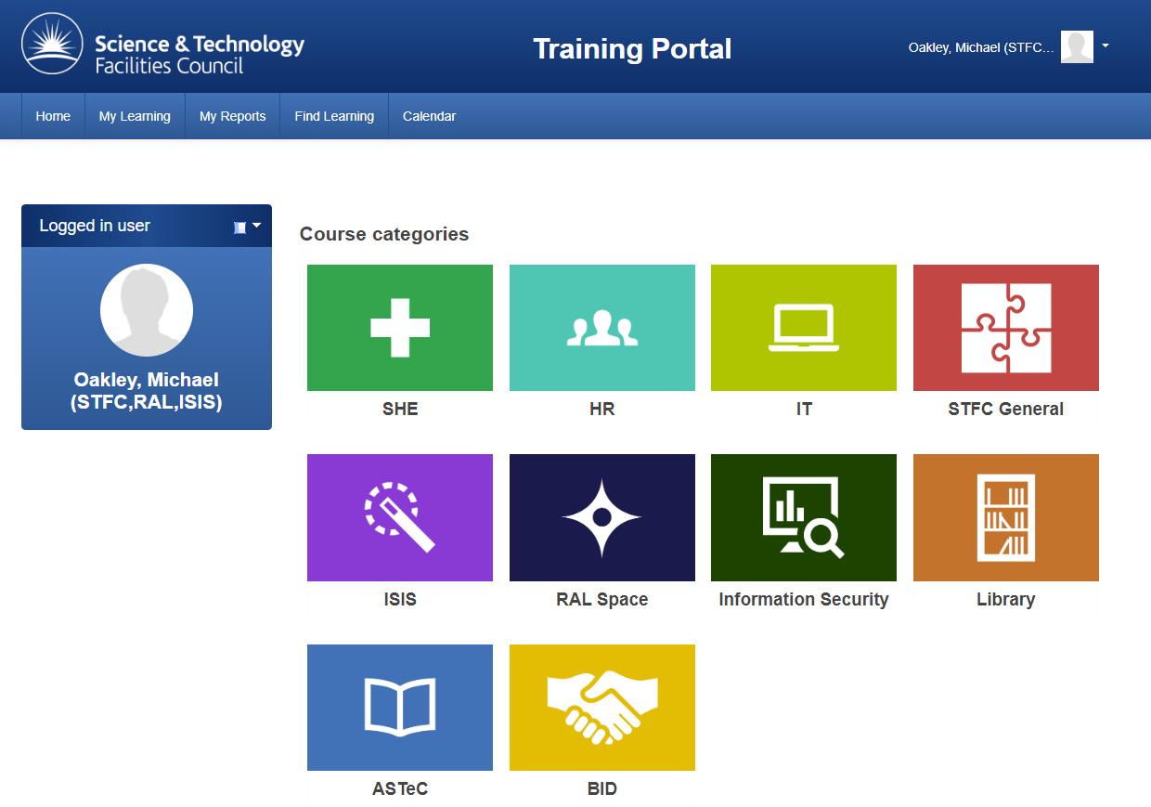
An introduction to
Modular Object-Oriented Dynamic Learning Environment
Used by STFC at https://lmsweb.stfc.ac.uk/moodle/

Slide 3
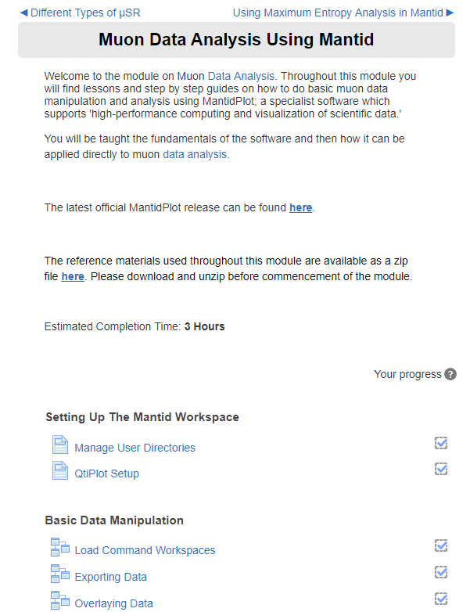
Previous use of e-learning for software

Slide 4
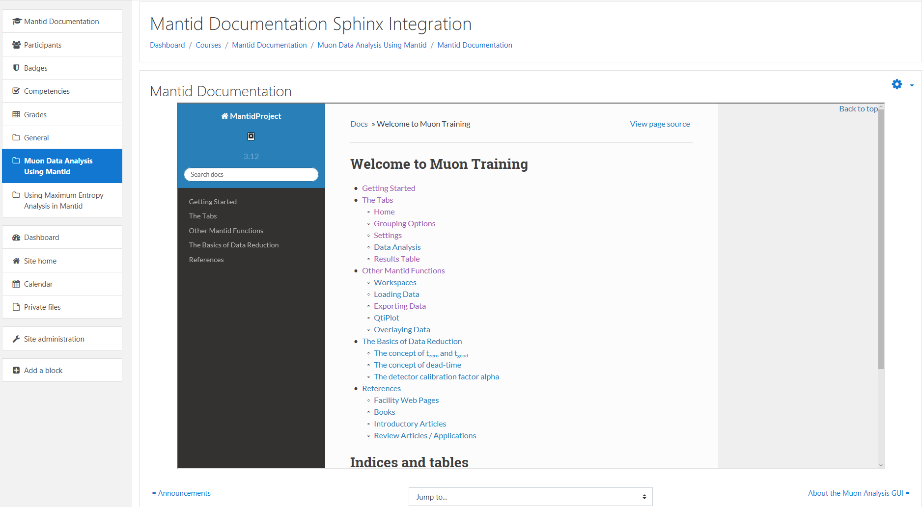
Integration with outside resources
Outside documentation embedded and used in
conjunction with exercises

Slide 5
Preliminary ideas for SasView e-Learning
Collating existing resources
Allows for simpler organisation
Easily navigable and accessible for users
Integration of these resources with new or updated tutorials to ensure key understanding
Other suggestions or queries?

